Slide 1
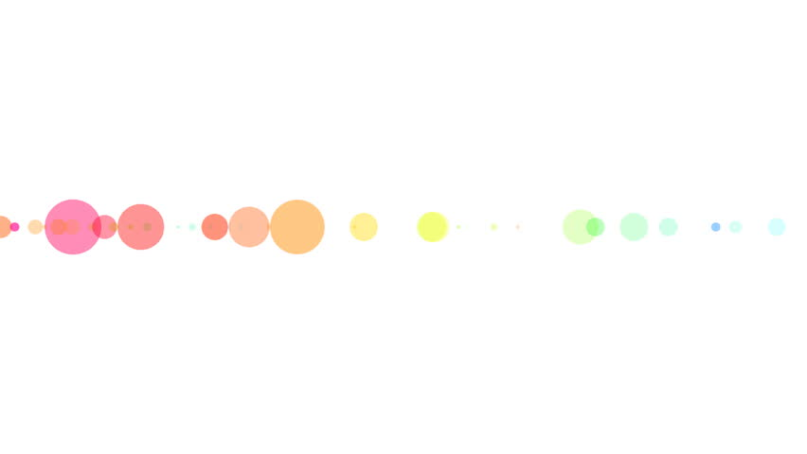
Turning Design Mock-ups into Code using Deep Learning
Samdharsi Kumar (17)
Esha Vijayvargiya (56)
Harsh Vyas (59)

Slide 2
Table of Contents
Introduction
Abstract
Problem Definition
Literature Survey
Proposed System
Expected outcome
Future Scope
References

Slide 3
Introduction
The time required to test an idea should be zero. As interface designers, sketching and visualizing is an intuitive method of expressing a concept. This projects aims to streamline the process by skipping a few steps in the product development lifecycle and instantly translates screenshots into a finished product.
As the machine learning movement gains steam and interfaces become more standardized, we believe that artificial intelligence assisted design and development will be baked into the next generation of programming.

Slide 4
Abstract
Transforming a graphical user interface screenshot created by a designer into computer code is a typical task conducted by a developer in order to build customized software, websites, and mobile applications.
Through this project, we show that deep learning methods can be leveraged to train a model end-to-end to automatically generate code from a single input image with moderate to high accuracy for various different platforms

Slide 5
Problem Definition
We can divide our problem into three sub-problems.
First, a computer vision problem of understanding the given scene (i.e. in this case, the GUI image) and inferring the objects present, their identities and positions (i.e. buttons, labels, element containers).
Second, a language-modelling problem of understanding text (i.e. in this case, computer code) and generating syntactically and semantically correct samples.
Finally, the last challenge is to use the solutions to both previous sub-problems by exploiting the latent variables inferred from scene understanding to generate corresponding textual descriptions (i.e. computer code rather than English) of the objects represented by these variables.

Slide 6
Literature Survey
Reference No. | Paper Title | Author | Year | Key Findings | Research Gaps
1 | Pix2code: Generating Code from a Graphical User Interface Screenshot | Tony Beltramelli | 2016 | Transforming a graphical user interface screenshot created by a designer into computer to build customized software. | The code, which is generated from the screenshot, is restricted to only few coding platforms.
2 | What You Get Is What You See: A Visual Markup Decompiler | Yuntian Deng, Anssi Kanervisto, Alexander M. Rush | 2015 | Building on recent advances in image caption generation and optical character recognition (OCR). | Standard mode of language is required for the generation of code.
3 | Neural machine translation by jointly learning to align and translate | Dzmitry Bahdanau | 2017 | Neural machine translation is a recently proposed approach to machine translation. Unlike the traditional statistical machine translation. | The time required to generate code from the screenshot depends upon the complexity of the webpage.

Slide 7
Proposed System
SS2code is a novel approach based on Convolutional and Recurrent Neural Networks allowing the generation of computer code from a single GUI screenshot as input. Our model will be able to generate computer code from the pixel values of the input image alone.
That is, no engineered feature extraction pipeline is designed to pre-process the input data. Our research demonstrates the effectiveness of this method for generating computer code for various platforms

Slide 8
Expected Outcome
Building on recent advances in image caption generation and
optical character recognition (OCR), we present a general purpose, deep learning-based system to decompile an image into presentational markup.
The model employs a convolutional network for text and layout recognition in tandem with an attention-based neural machine translation system. To train and evaluate the model, we introduce a new dataset of real-world rendered mathematical expressions paired with LaTeX markup, as well as a synthetic dataset of web pages paired with HTML snippets.

Slide 9
Future Scope
While this research demonstrates the potential of such a system to automate the process of implementing GUIs, it only scratches the surface of what is possible.
In order to exploit the graphical nature of our input, we can borrow methods from the computer vision literature. In fact, an important number of research have shown that deep neural networks are able to learn latent variables describing objects in an image and generate a variable-length textual
Possible future directions for this work include: scaling the system to run on full websites or for document decompilation, using similar approach for handwritten mathematical expressions or HTML from informal sketches, or combining these methods with neural inference machines such as MemNNs

Slide 10
References
D. Bahdanau, K. Cho, and Y. Bengio. Neural machine translation by jointly learning to align and translate. arXiv preprint arXiv:1409.0473, 2014.
M. Balog, A. L. Gaunt, M. Brockschmidt, S. Nowozin, and D. Tarlow. Deepcoder: Learning to write programs. arXiv preprint arXiv:1611.01989, 2016.
B. Dai, D. Lin, R. Urtasun, and S. Fidler. Towards diverse and natural image descriptions via a conditional gan. arXiv preprint arXiv:1703.06029, 2017.
Thank You!

